Slide 1
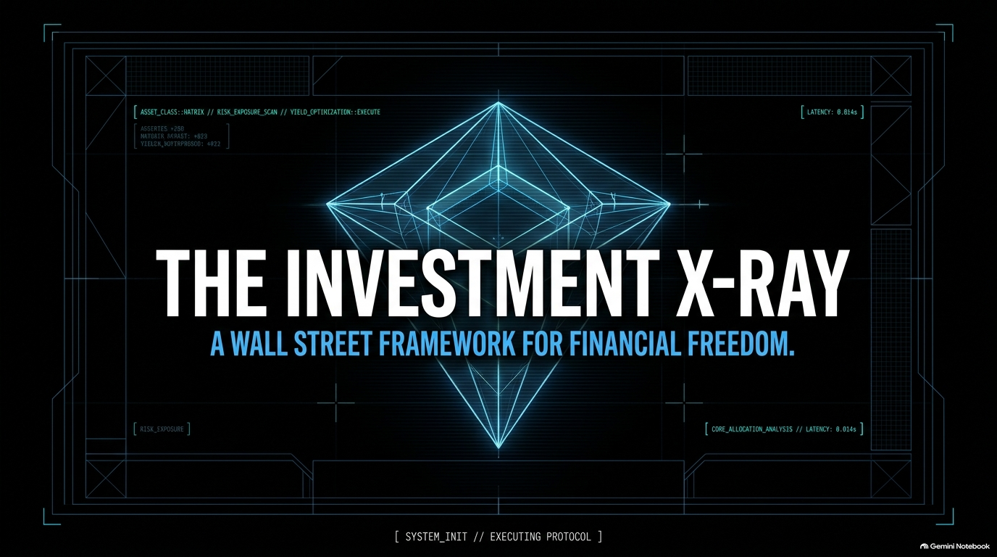
Notes:
Opening / Hook:
Welcome everyone. Today, we’re unpacking a system that I learned during my time on Wall Street at Goldman Sachs and Credit Suisse—a framework that I believe has made more millionaires than a Harvard MBA.
The Problem:
Most people were never taught how to make investment decisions. They make choices based on social media trends, headlines, or FOMO.
Personal Background & Context:
Briefly introduce Sharran Srivatsaa: Built two billion-dollar companies, currently CEO at Acquisition.com alongside Alex and Leila Hormozi.
Share the backstory: A billionaire client at Goldman Sachs introduced this foundational four-part formula for evaluating any asset.
Objective of Today’s Session:
By the end of this presentation, you will have an institutional-grade rubric to interrogate any pitch, structure your cash flow, and build true financial independence.
https://www.youtube.com/watch?v=jGt4vbdZ1yo

Slide 2
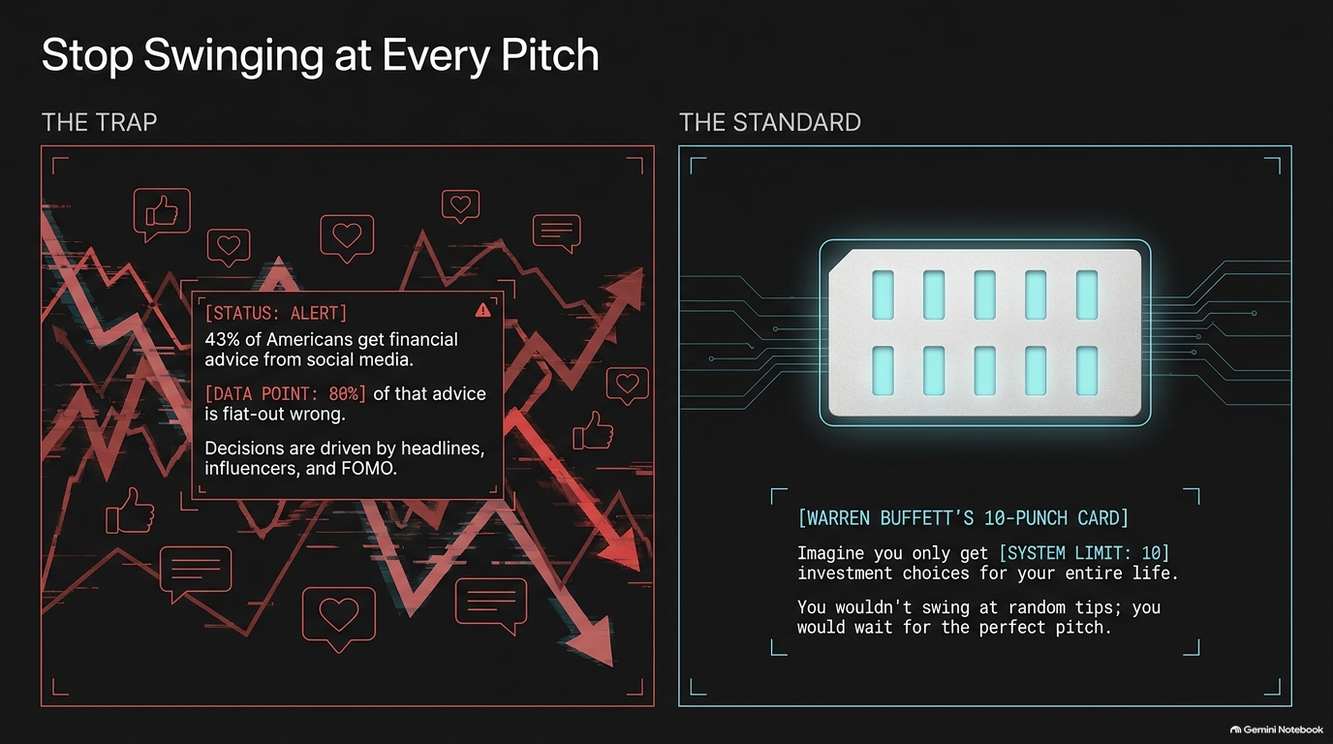
Notes:
The Reality Check:
43% of Americans get their financial advice from social media, and 80% to 90% of that advice is flat-out wrong.
Most influencers are not qualified advisers; they peddle hype, not frameworks.
The Baseball Analogy & Warren Buffett’s 10-Punch Card:
Imagine you graduate and are given a physical punch card with only 10 slots. Every investment you make in your lifetime consumes one punch.
In baseball, you don't get called out for watching pitches go by. You can wait on the sidelines until you get the absolute perfect pitch right down the middle.
Key Takeaway:
Stop swinging at random tips, influencer posts, and peer pressure. Protect your capital by being ruthlessly selective.

Slide 3
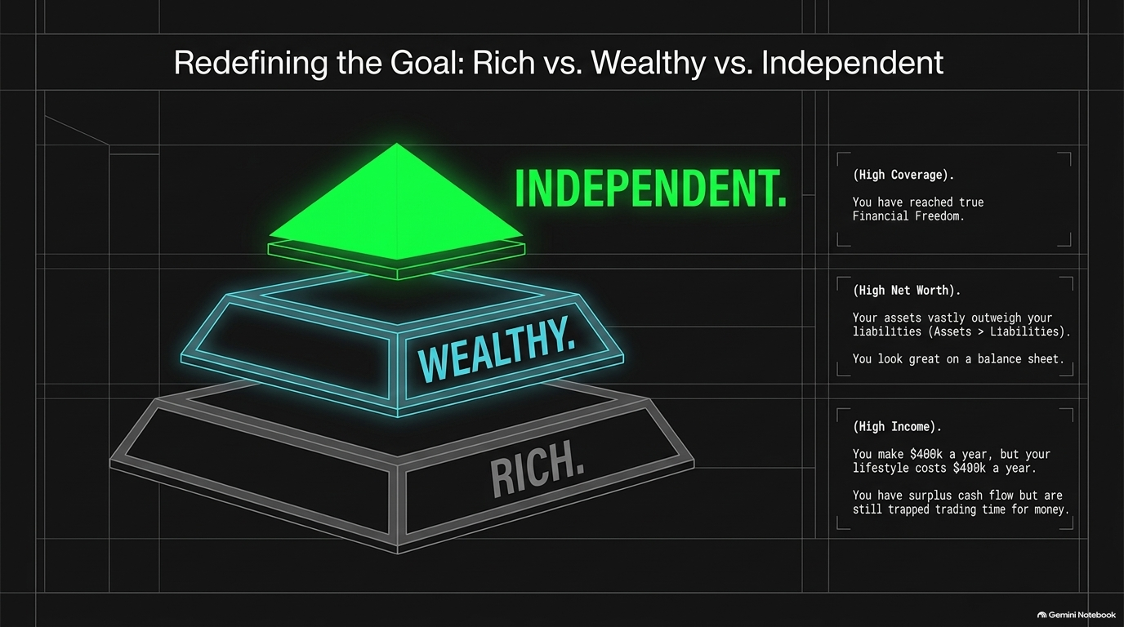
Notes:
Breaking Down the Spectrum:
Rich (High Income): Making $400k a year, but spending $400k a year. High cash flow, zero leverage over time. You are still trapped trading time for money.
Wealthy (High Net Worth): Assets vastly exceed liabilities on paper. Looks great on a balance sheet, but if those assets don't produce cash, you remain illiquid.
Independent (High Coverage): True financial freedom. Your passive income streams exceed your monthly operating expenses.
Mindset Shift:
Society tells us to chase a massive net worth number (e.g., $55 million). But net worth is ego; coverage is freedom.

Slide 4
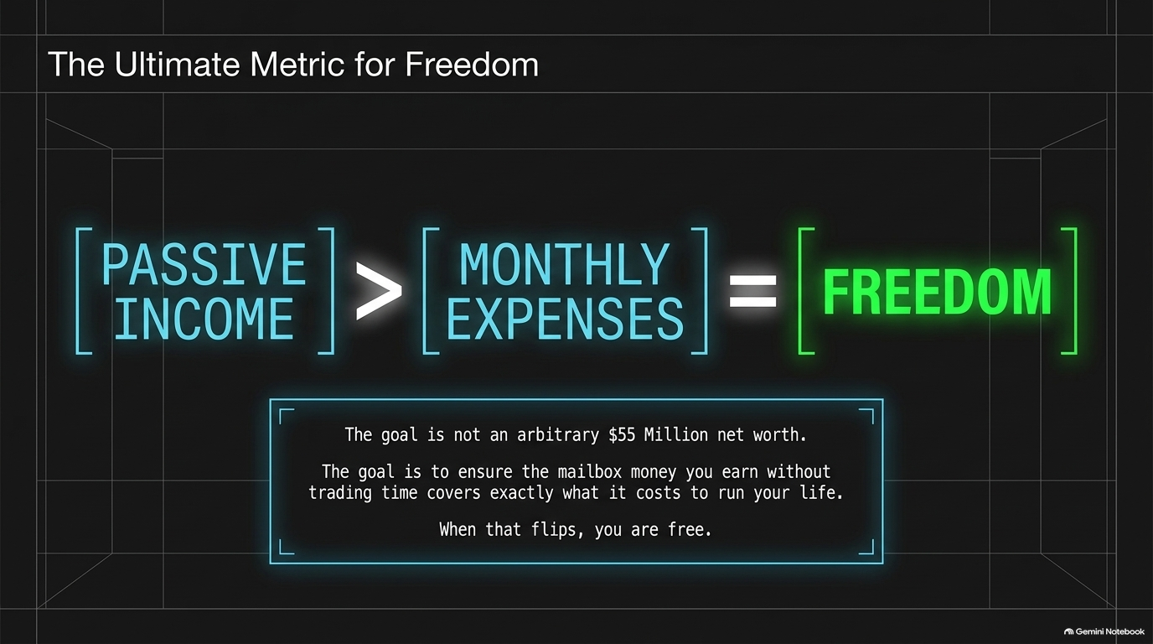
Notes:
The Crossover Equation:
Passive Income > Monthly Expenses = Freedom.
Explaining "Mailbox Money":
Freedom occurs when your assets generate enough recurring cash flow ("mailbox money") to pay for your baseline lifestyle without you having to punch a clock.
Practical Example:
If your monthly expenses are $9,000 and your passive assets generate $10,000/month, you are free. You can wake up every morning and ask, "What do I want to do today?" rather than "What must I do to survive?"

Slide 5
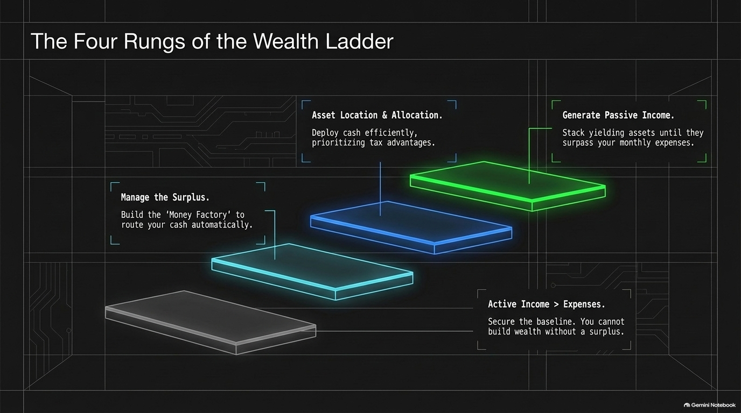
Notes:
Rung 1: Active Income > Expenses
You cannot build wealth without a baseline surplus. Step one is earning more than you spend.
Rung 2: Manage the Surplus ("The Money Factory")
Automate your cash routing so discipline isn't reliant on willpower.
Rung 3: Asset Location & Allocation
Deploy capital efficiently while minimizing tax drag (e.g., entity structure, location advantages).
Rung 4: Generate Passive Income
Stack yielding assets until passive cash flow crosses over your monthly expenses.

Slide 6
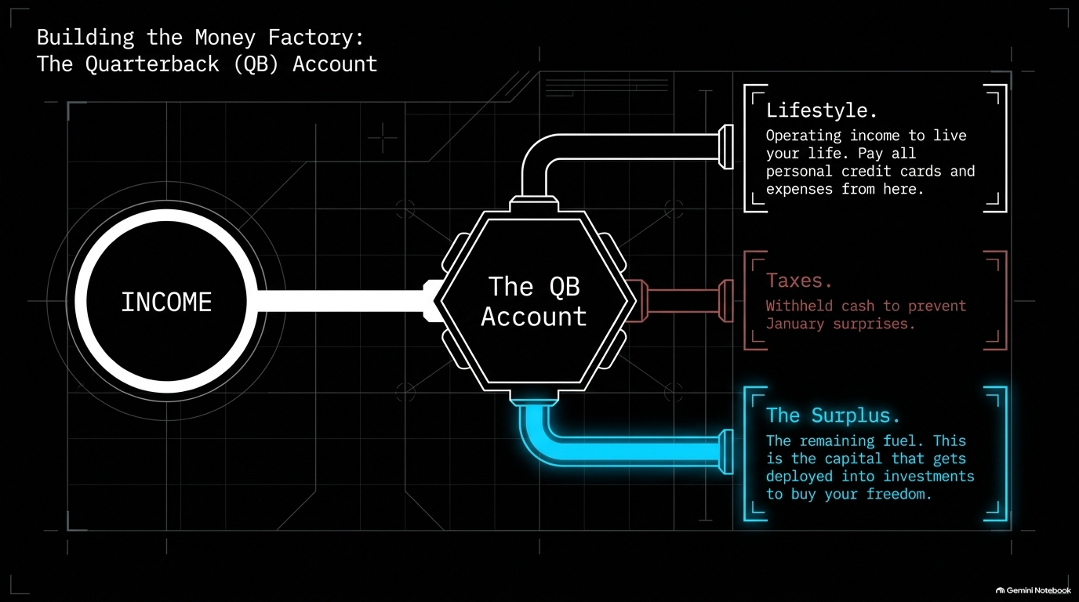
Notes:
Concept of the Quarterback Account:
All incoming revenue enters a central checking account (The QB Account) whose sole job is to route funds systematically.
The Three Output Channels:
Lifestyle Account: Operating income to pay credit cards and personal overhead. Capped to prevent lifestyle creep.
Tax Account: Withheld immediately to avoid tax-season surprises.
Surplus Account: The fuel that buys your freedom. Deployed into income-generating and growth assets.

Slide 7
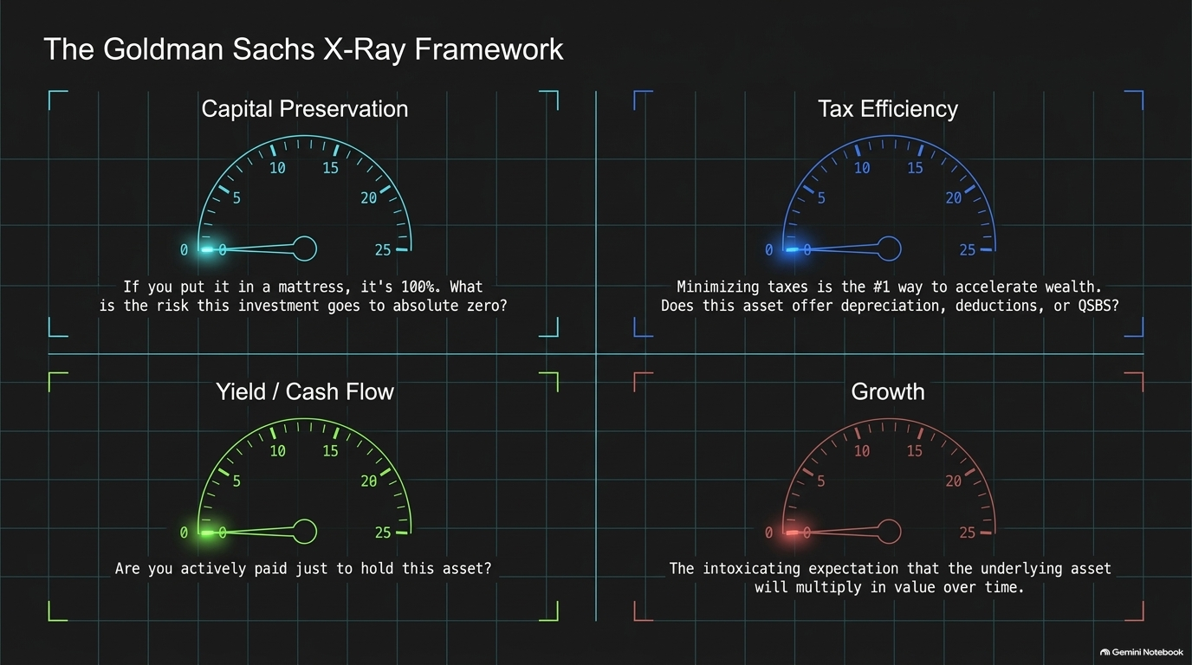
Notes:
Introducing the 100-Point Rubric (4 Pillars x 25 Points):
Capital Preservation (0–25 pts): What is the probability of this asset going to absolute zero? (Cash under a mattress = 100% preservation, zero return).
Tax Efficiency (0–25 pts): Taxes are the #1 drag on wealth creation. Does this asset provide depreciation, cost segregation, or QSBS exemptions?
Yield / Cash Flow (0–25 pts): Does this asset pay you to own it while you wait?
Growth (0–25 pts): What is the upside multiplier on underlying principal?

Slide 8
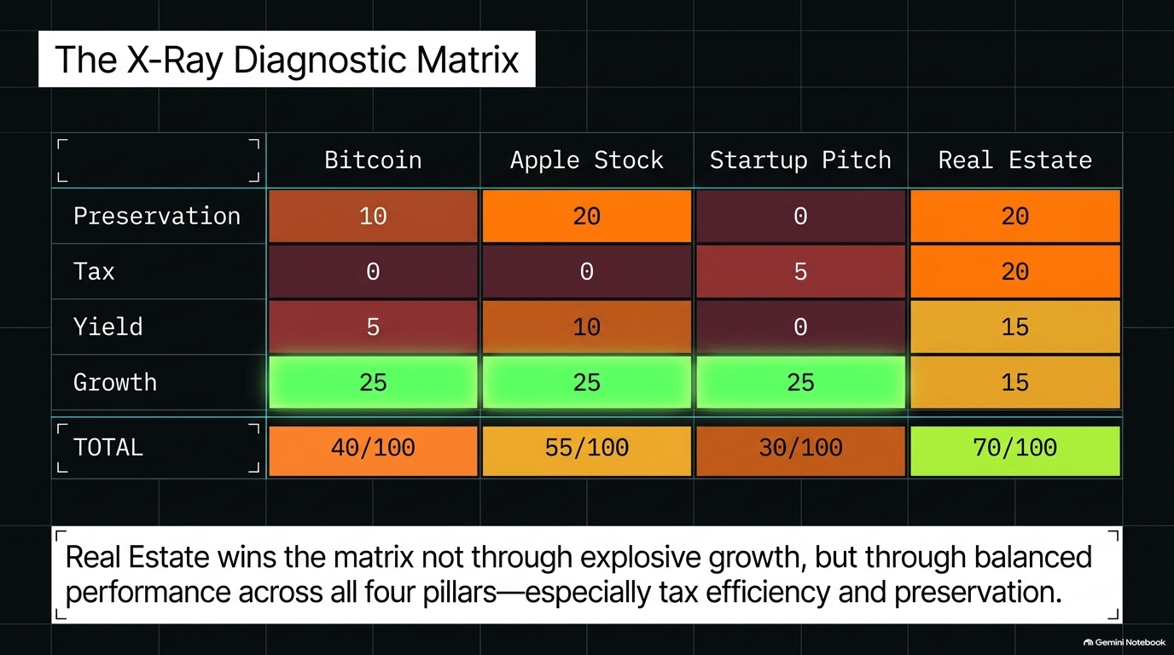
Notes:
Comparing Asset Classes live through the rubric:
Bitcoin (40/100): Low preservation (10), zero tax efficiency (0), minimal yield (5), high growth potential (25). (Note: Buy a small piece if you have FOMO, but recognize its risk profile).
Apple Stock (55/100): Strong preservation (20), low tax efficiency (0), modest yield/dividend (10), high growth (25).
Startup Pitch (30/100): High risk of total loss (0 preservation), speculative tax/growth, zero yield.
Real Estate (70/100): Balanced performance—strong preservation (20), excellent tax advantages (20), steady yield (15), solid growth (15).
Core Principle: Real Estate wins not because of explosive upside, but through all-around stability and tax efficiency.

Slide 9
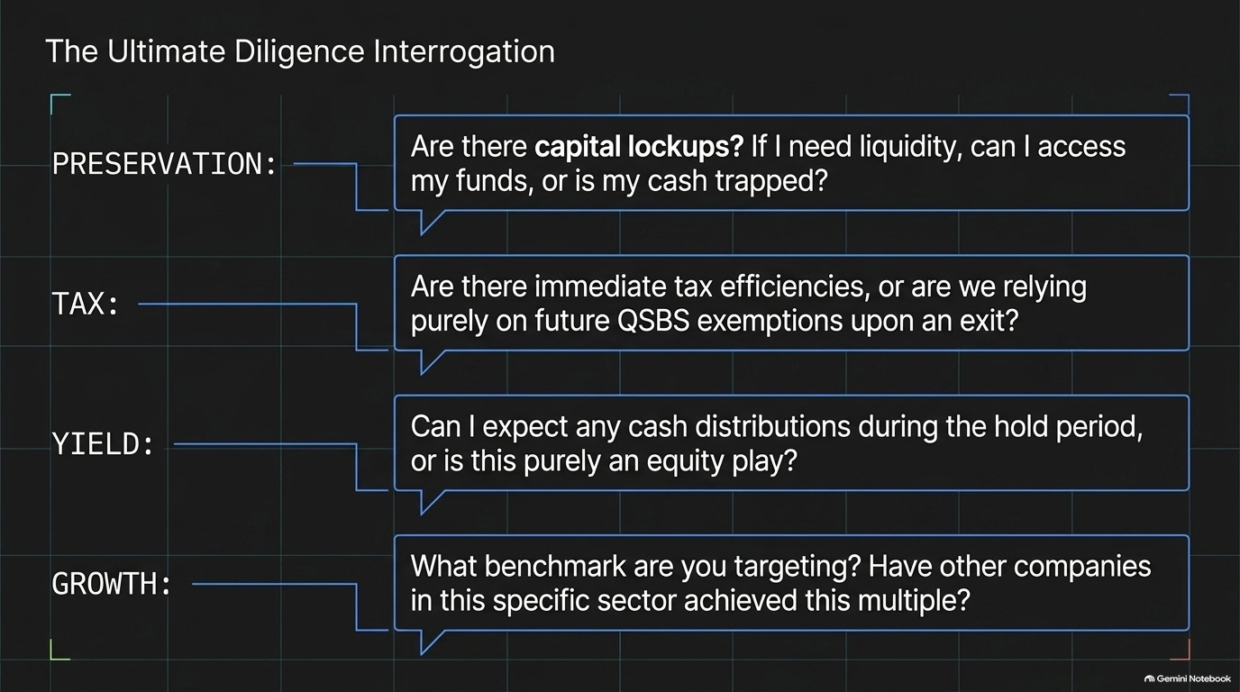
Notes:
Using the X-Ray to Ask Better Questions:
Preservation Questions: Are there capital lockups? How liquid is my cash if I need to exit?
Tax Questions: Are there immediate tax benefits (e.g., depreciation) or are we relying solely on future capital gains?
Yield Questions: Will I receive cash distributions during the hold period, or is this 100% an equity play?
Growth Questions: What benchmarks are being targeted, and have peers in this sector achieved these multiples?

Slide 10
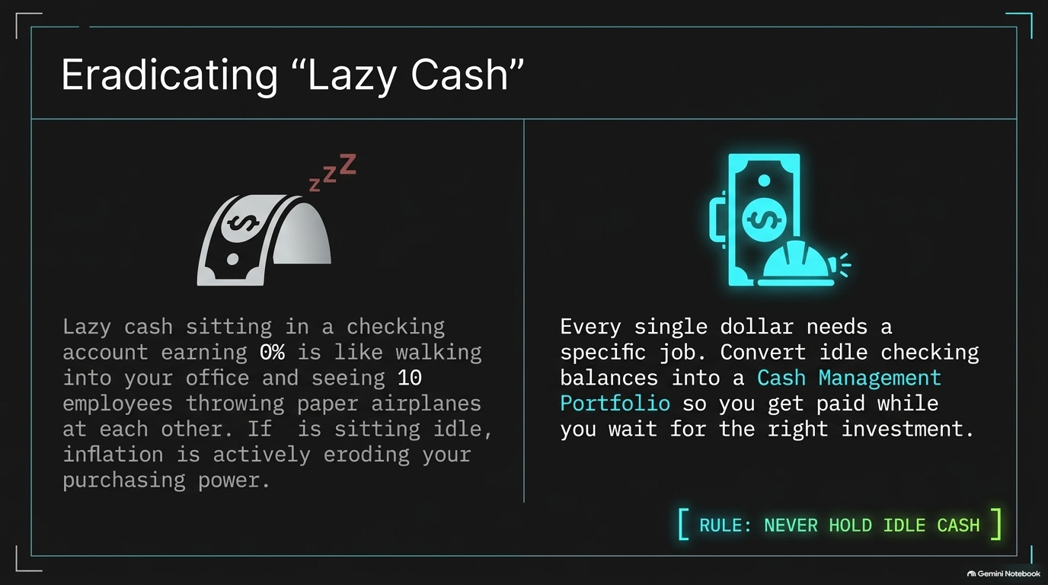
Notes:
The Lazy Employee Analogy:
Holding idle cash in a 0% checking account is like walking into your office and seeing 10 employees throwing paper airplanes.
The Rule:
Every single dollar needs a job. Inflation constantly erodes purchasing power.
Actionable Step:
Move excess operating cash out of primary checking into a structured Cash Management Portfolio so you get paid to wait for the next great investment.

Slide 11
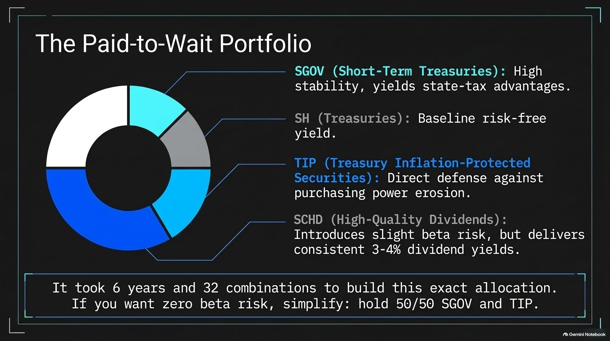
Notes:
Portfolio Structure Breakdown:
SGOV (Short-Term Treasuries): High stability, state-tax benefits.
SH (Treasuries): Baseline risk-free yield.
TIP (Treasury Inflation-Protected Securities): Directly defends against inflation drag.
SCHD (High-Quality Dividends): 3–4% yield, adding equity exposure.
Simplified Strategy:
For zero beta risk, simplify to a 50/50 split of SGOV and TIP.

Slide 12
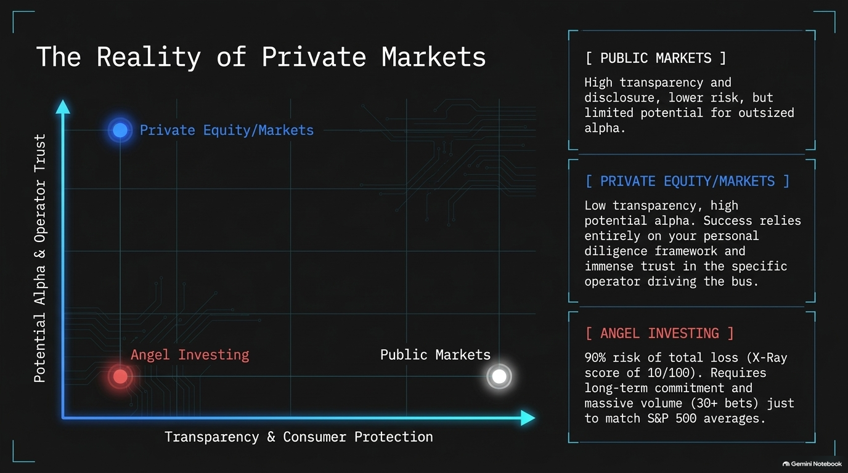
Notes:
Public vs. Private Markets:
Public Markets: High transparency, strong investor protections, lower outsized alpha potential.
Private Equity / Real Estate: Low public transparency, high potential alpha. Requires deep operator trust and rigorous diligence.
Angel Investing: 90%+ risk of total capital loss. Requires 30+ bets over years just to match baseline S&P 500 performance.
Guidance: Secure your passive income crossover before making speculative private bets.
Slide 13: Pu

Slide 13
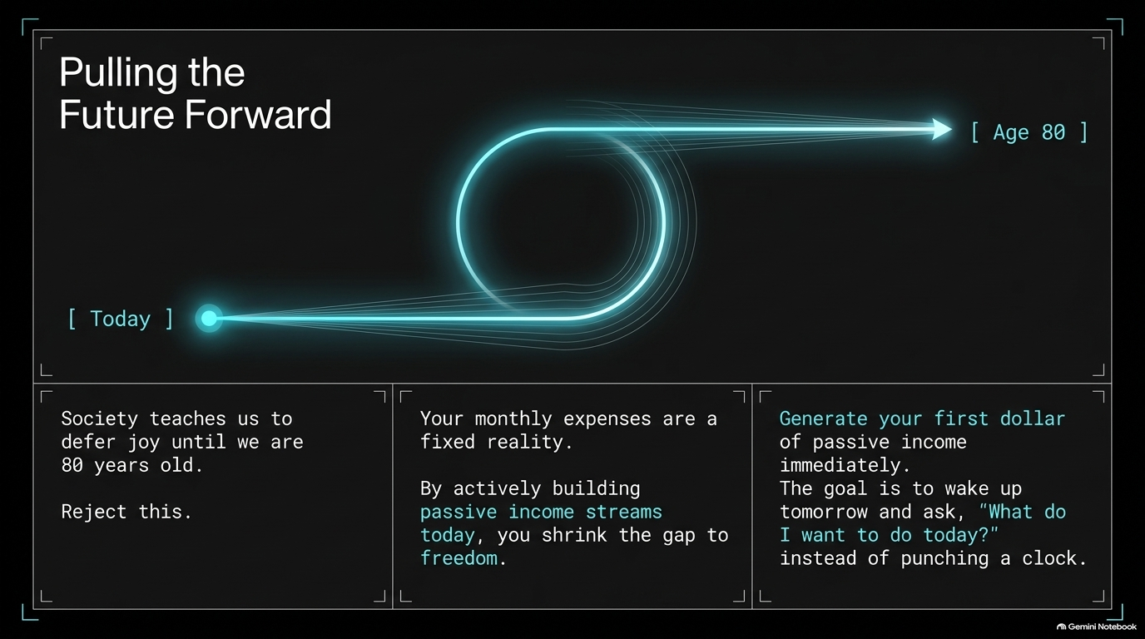
Notes:
Rejecting Deferred Life:
Society conditions us to work 40+ years and defer enjoyment until age 80.
The Crossover Philosophy:
Monthly expenses are predictable. By generating passive income today, you shrink the timeline to financial freedom immediately.
The Outcome:
Pulling the future forward allows you to spend your prime years doing what you love rather than trading time for a paycheck.

Slide 14
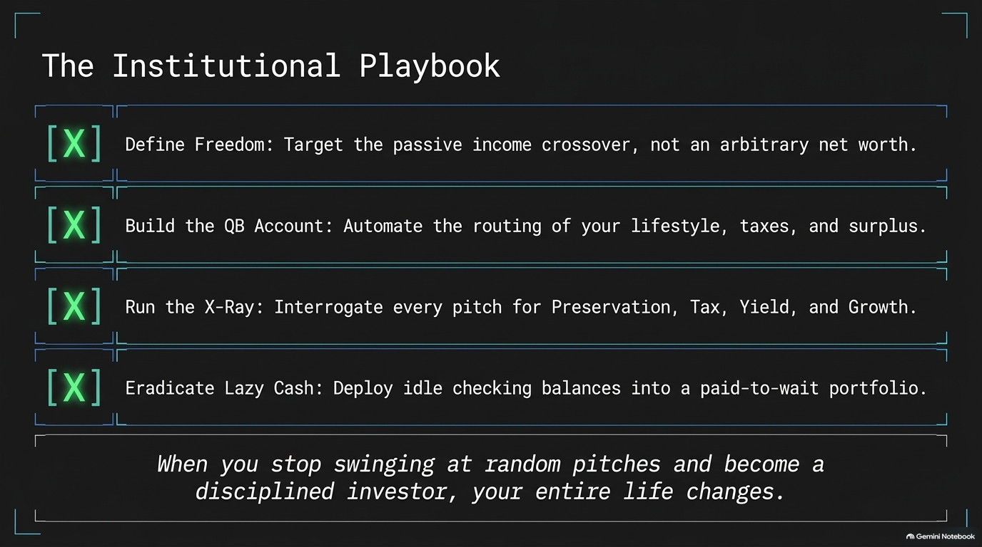
Notes:
Summary Checklist:
Define Freedom: Focus on passive income crossover.
Build the QB Account: Automate your surplus.
Run the X-Ray: Interrogate pitches using Preservation, Tax, Yield, and Growth.
Eradicate Lazy Cash: Put idle funds to work in a cash management portfolio.

Slide 15
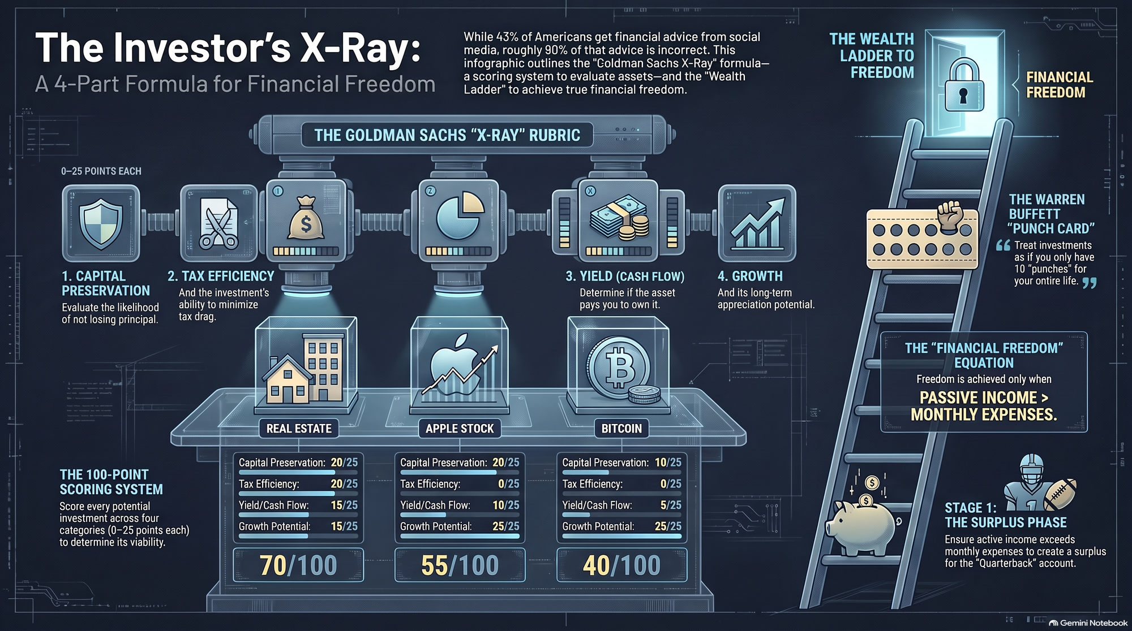
Notes:
Concluding Takeaway:
Summarize the core 100-point rubric and the ladder to financial freedom.
Remind the audience: Wealth isn't built by taking reckless swings at every hot tip—it's built by disciplined underwriting and systematic execution.

